Slide 1

Reinforcement Learning: Fundamentals and Practices

Slide 2

CONTENTS
01
Introduction to Reinforcement Learning
02
Mathematical Foundations
03
Model-Free Reinforcement Learning
04
Deep Reinforcement Learning
05
How to train your reinforcement learning model
06
Practical Implementation and Case Studies
07
Conclusion and Future Work

Slide 3


01
Introduction to Reinforcement Learning

Slide 4

Definition and Basic Concepts
Definition of Reinforcement Learning
Reinforcement learning is a type of machine learning where an agent learns to make decisions by taking actions in an environment to maximize some notion of cumulative reward. It differs from supervised learning as it does not require labeled data and from unsupervised learning as it has clear goals and feedback mechanisms.
Key Elements: Agent, Environment, and Reward
Applications of Reinforcement Learning
In reinforcement learning, the agent is the decision-maker or learner. The environment is everything that the agent interacts with. The reward signal is the feedback from the environment that guides the agent's actions. The agent's goal is to maximize the cumulative reward over time.
Reinforcement learning has a wide range of applications, including robotics for tasks like navigation and manipulation, gaming to develop intelligent game-playing agents, and recommendation systems to personalize content for users. It is also used in finance for portfolio management and in healthcare for treatment planning.

Slide 5
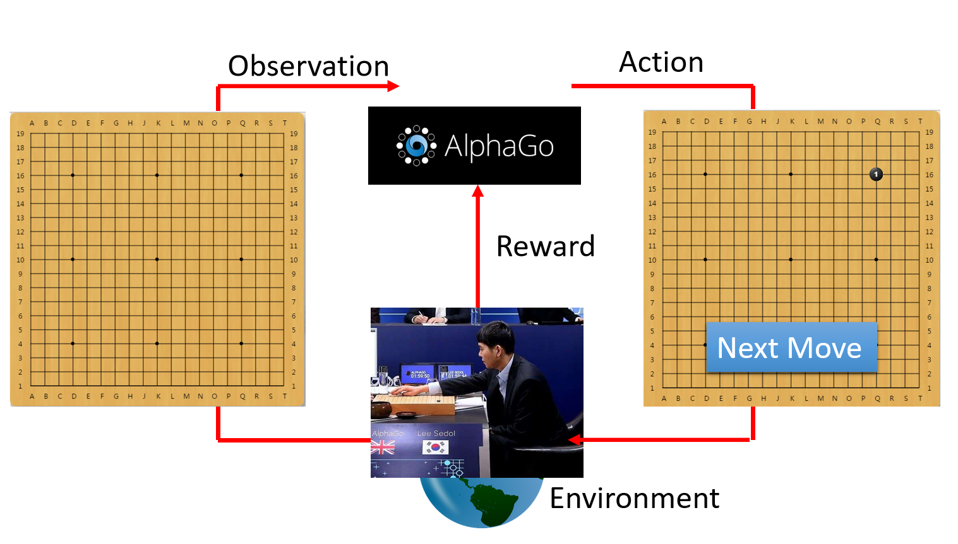
Example

Slide 6

Historical Development
01
Early Beginnings and Theoretical Foundations
The concept of reinforcement learning has its roots in psychology and early work on learning automata. The theoretical foundations were laid with the development of Markov decision processes and dynamic programming techniques, which provided a mathematical framework for sequential decision-making under uncertainty.
02
Key Milestones and Breakthroughs
Key milestones include the development of the Q-learning algorithm, which is a model-free reinforcement learning method that can learn optimal policies without a model of the environment. Another breakthrough was the use of deep learning techniques in reinforcement learning, leading to the development of deep Q-networks and significant advancements in the field.
Current Trends and Future Directions
03
Current trends in reinforcement learning include the integration with other AI techniques like transfer learning and multi-agent systems. There is also a focus on improving the sample efficiency of reinforcement learning algorithms. Future directions may involve more complex environments, real-time decision-making, and ethical considerations in the deployment of reinforcement learning systems.

Slide 7
02
Mathematical Foundations

Slide 8
Markov Decision Processes
Components of MDP
Bellman Equations
Value Functions and Policies
A Markov decision process consists of states, actions, transition probabilities, and rewards. States represent the current situation of the agent, actions are the possible decisions the agent can make, transition probabilities describe the likelihood of moving from one state to another given an action, and rewards provide feedback on the quality of the action.
The Bellman equations are fundamental to reinforcement learning. They provide a recursive relationship between the value of a state and the values of subsequent states. The Bellman expectation equation expresses the value of a state in terms of the expected values of the next state and reward, while the Bellman optimality equation expresses the optimal value function in terms of the maximum expected value of the next state and reward.
Value functions estimate the long-term reward that can be expected for each state or state-action pair. Policies define the mapping from states to actions and determine the agent's behavior. The goal of reinforcement learning is to find the optimal policy that maximizes the expected cumulative reward.

Slide 9

Dynamic Programming
01
02
03
Policy Iteration
Value Iteration
Limitations of Dynamic Programming
Policy iteration is a dynamic programming algorithm that alternates between policy evaluation and policy improvement. Policy evaluation computes the value function for a given policy, while policy improvement updates the policy based on the value function. This process continues until the policy converges to the optimal policy.
Value iteration is another dynamic programming algorithm that iteratively updates the value function until it converges to the optimal value function. Once the optimal value function is obtained, the optimal policy can be derived by selecting the action that maximizes the expected value for each state. Value iteration is more efficient than policy iteration in some cases.
Dynamic programming methods have limitations, such as the curse of dimensionality, which makes them impractical for large state spaces. They also require a complete model of the environment, which may not always be available. These limitations have led to the development of model-free reinforcement learning methods.

Slide 10
03
Model-Free Reinforcement Learning

Slide 11



Monte Carlo Methods
Basic Principles
Advantages and Disadvantages
On-Policy vs. Off-Policy Learning
Monte Carlo methods estimate the value function by averaging the returns obtained from complete episodes. They are model-free and can handle large state spaces, but they require complete episodes to update the value function, which can be inefficient in some cases.
On-policy Monte Carlo methods learn the value function for the current policy, while off-policy methods learn the value function for a different target policy. Off-policy learning allows the agent to learn from data generated by a different behavior policy, which can be more efficient and flexible.
The advantages of Monte Carlo methods include their simplicity and the ability to handle large state spaces. However, they have some disadvantages, such as high variance in the estimates and the need for complete episodes, which can make them slow to converge.

Slide 12
Temporal-Difference Learning
TD Learning Basics
Temporal-difference learning is a model-free reinforcement learning method that updates the value function based on the difference between estimated and actual values. It combines ideas from Monte Carlo methods and dynamic programming, allowing the agent to learn from incomplete episodes and update the value function incrementally.
TD(λ) and Eligibility Traces
TD(λ) is an extension of temporal-difference learning that uses eligibility traces to combine the benefits of one-step and multi-step updates. Eligibility traces keep track of the states and actions that are eligible for updates based on their recency and importance, allowing the agent to learn more efficiently and effectively.
Comparison with Monte Carlo Methods
Compared to Monte Carlo methods, temporal-difference learning has the advantage of being able to learn from incomplete episodes, which makes it more efficient in many cases. However, it may have higher bias in the estimates, especially for small values of the learning rate.

Slide 13

Q-Learning and SARSA
Q-Learning Algorithm
Q-learning is a model-free, off-policy reinforcement learning algorithm that learns the optimal action-value function. It updates the Q-values based on the maximum Q-value of the next state, allowing the agent to learn the optimal policy without following it. Q-learning is widely used due to its simplicity and effectiveness.
SARSA Algorithm
SARSA is an on-policy reinforcement learning algorithm that learns the action-value function for the current policy. It updates the Q-values based on the actual action taken in the next state, which makes it more conservative than Q-learning. SARSA is useful for learning policies that are more robust to exploration.
Differences and Use Cases
The main difference between Q-learning and SARSA is their exploration strategies. Q-learning is more exploratory and can find the optimal policy more quickly, while SARSA is more conservative and can handle noisy environments better. The choice between them depends on the specific problem and the desired trade-off between exploration and exploitation.

Slide 14
04
Deep Reinforcement Learning

Slide 15
Deep Q-Networks
Architecture and Training
Deep Q-networks (DQN) combine deep neural networks with Q-learning to handle high-dimensional state spaces. The architecture typically consists of convolutional layers for image inputs and fully connected layers for processing the features. Training involves using experience replay to break the correlation between consecutive samples and a target network to stabilize the training process.
Improvements and Variants
Applications and Limitations
Several improvements and variants of DQN have been proposed to address its limitations. These include double DQN, which reduces overestimation of Q-values, and dueling DQN, which separates the estimation of state value and advantage function. These improvements have led to better performance and stability in various tasks.
DQN has been successfully applied to a wide range of tasks, such as playing Atari games and robotic control. However, it has some limitations, such as high sample complexity and difficulty in handling continuous action spaces. These limitations have motivated the development of other deep reinforcement learning methods.

Slide 16
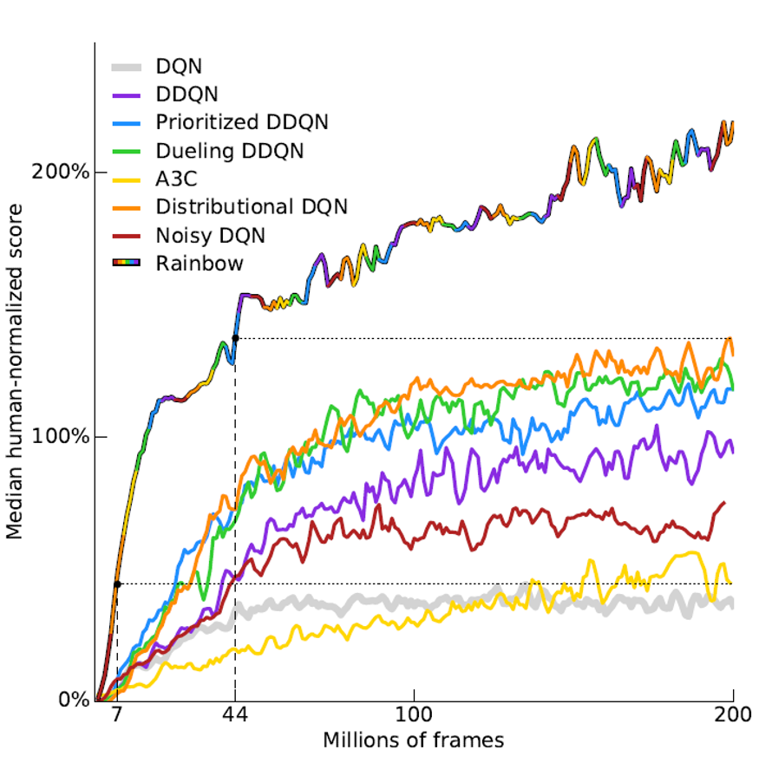
Deep Q-Networks

Slide 17
Policy Gradient Methods
01
Basic Policy Gradient
Policy gradient methods directly optimize the policy by updating the parameters in the direction of the gradient of the expected cumulative reward. The basic policy gradient algorithm uses the likelihood ratio method to estimate the gradient, allowing the agent to learn the optimal policy without estimating the value function.
02
Actor-Critic Methods
Actor-critic methods combine the benefits of policy gradient methods and value function estimation. The actor learns the policy, while the critic estimates the value function to provide a more accurate gradient estimate. This combination improves the stability and efficiency of policy gradient methods.
Proximal Policy Optimization
03
Proximal policy optimization (PPO) is a popular policy gradient method that addresses the issue of large policy updates leading to instability. It uses a trust region optimization technique to ensure that the new policy is close to the old policy, allowing for more stable and efficient training. PPO has been widely used in various reinforcement learning tasks.

Slide 18
Advanced Topics in Deep RL
Exploration Strategies
Transfer Learning and Multi-Agent RL
Safety and Ethics in RL
Exploration is a crucial aspect of reinforcement learning. Advanced exploration strategies include epsilon-greedy, Boltzmann exploration, and intrinsic motivation. These methods balance the trade-off between exploration and exploitation, allowing the agent to discover new states and actions while still exploiting known information.
Transfer learning in reinforcement learning involves transferring knowledge from one task to another to improve learning efficiency. Multi-agent reinforcement learning deals with scenarios where multiple agents interact with each other and the environment. These advanced topics are important for developing more intelligent and adaptive reinforcement learning systems.
Safety and ethics are critical considerations in the deployment of reinforcement learning systems. Safety involves ensuring that the agent's actions do not cause harm or unintended consequences. Ethics includes issues such as fairness, transparency, and accountability. Researchers are actively working on developing methods to address these challenges.

Slide 19
05
How to train your reinforcement learning model

Slide 20
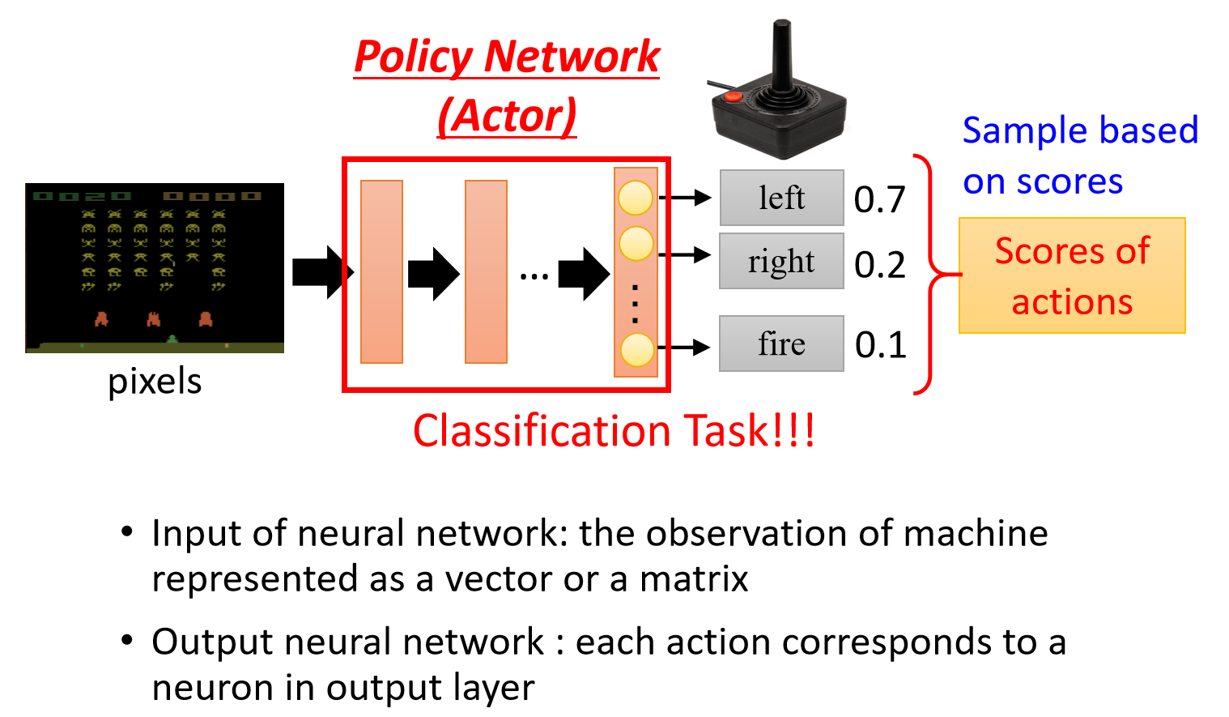
Step 1: Function with Unknown
Notes:
图中最左边为一游戏画面，下放为我方可操作对象，有left，right和fire三种act，其中击中上方的敌人可获得分数可以看作每次act后获得的reward为正数.由于使用的是sample,所以每次可能使用的行动是三种皆有可能。因为在实际情况中可能出现当前非最优选择但是在整体结果中最优。

Slide 21
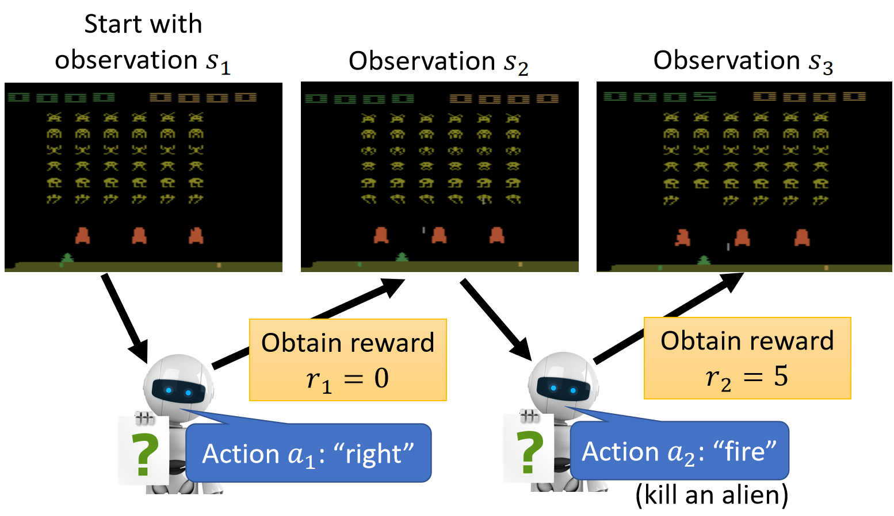
Step 2: Define “Loss”
Notes:
图中最左边为一游戏画面，下放为我方可操作对象，有left，right和fire三种act，其中击中上方的敌人可获得分数可以看作每次act后获得的reward为正数

Slide 22
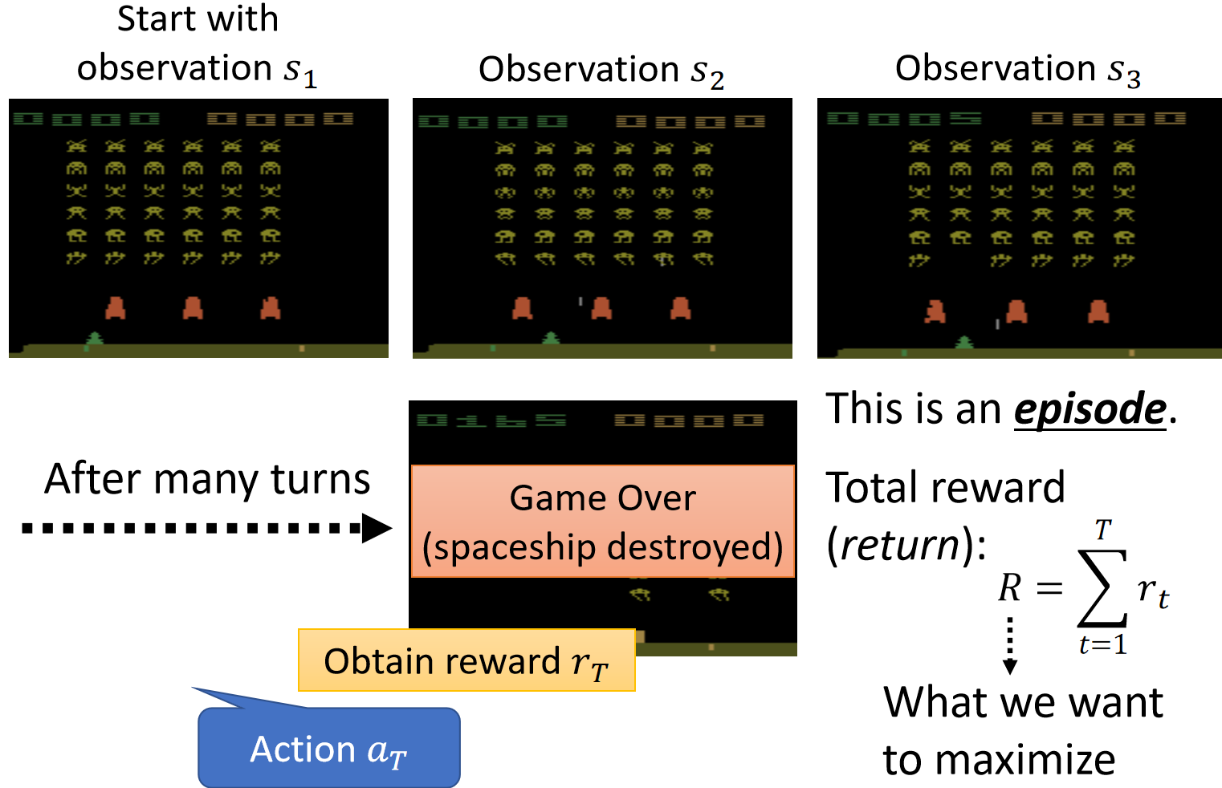
Step 2: Define “Loss”

Slide 23
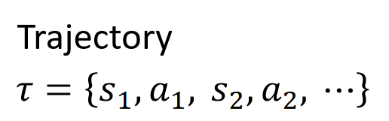
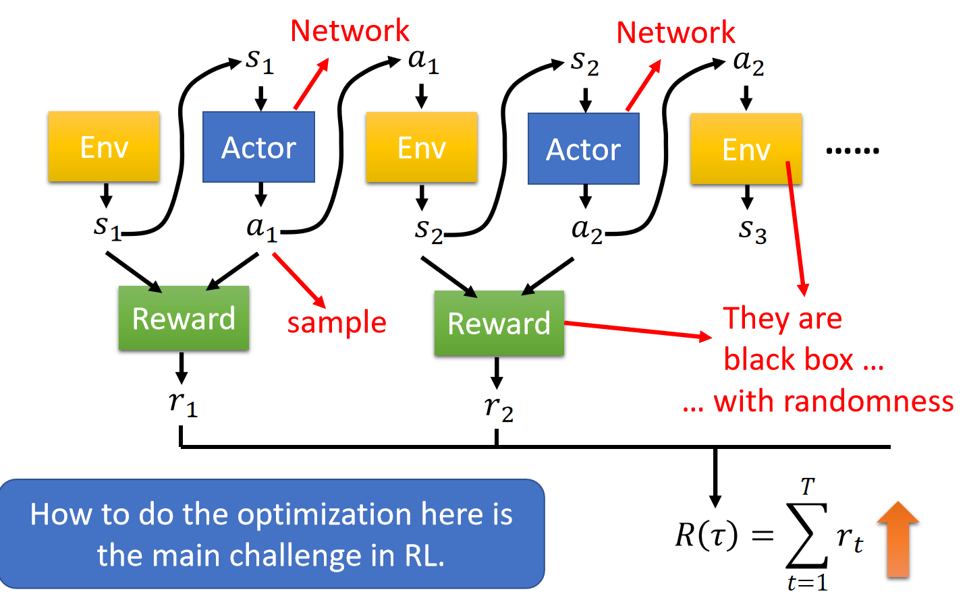
Step 3: Optimization

Slide 24
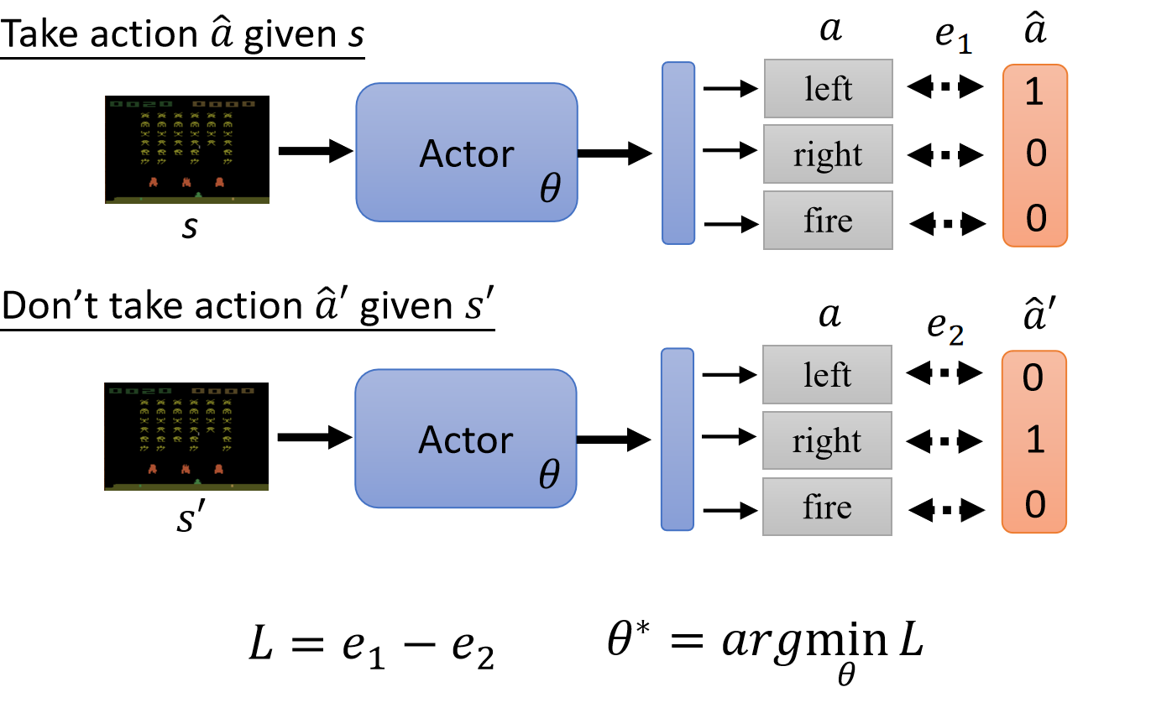
How to control your actor

Slide 25
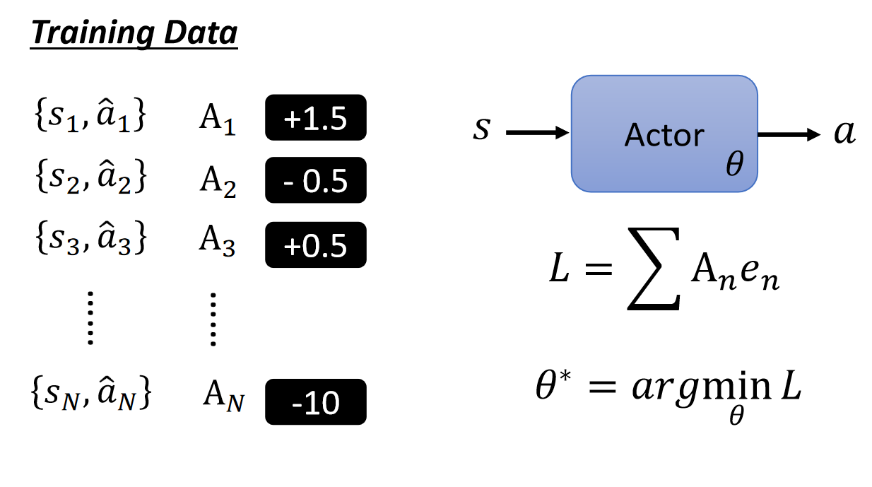
How to control your actor

Slide 26
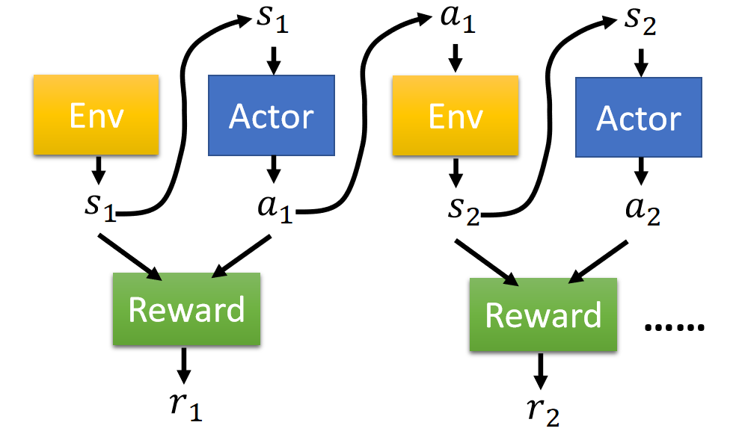
Holicy Gradient
An action affects the subsequent observations and thus subsequent rewards.
Reward delay: Actor has to sacrifice immediate reward to gain more long-term reward.

Slide 27
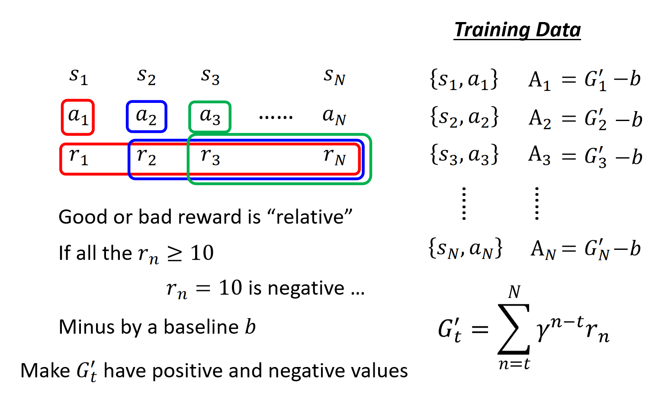
Holicy Gradient
Notes:
普通Gt就是不加参数$γ$的样子，这里要减去basline是因为在有的环境中每次act的反馈都是正数，模型会一直优化，减去baseline可以把一些行动没那么优势的步骤变成负数给agent的reward为负数，方便模型训练。更优化的方法在后面actor-critic中

Slide 28
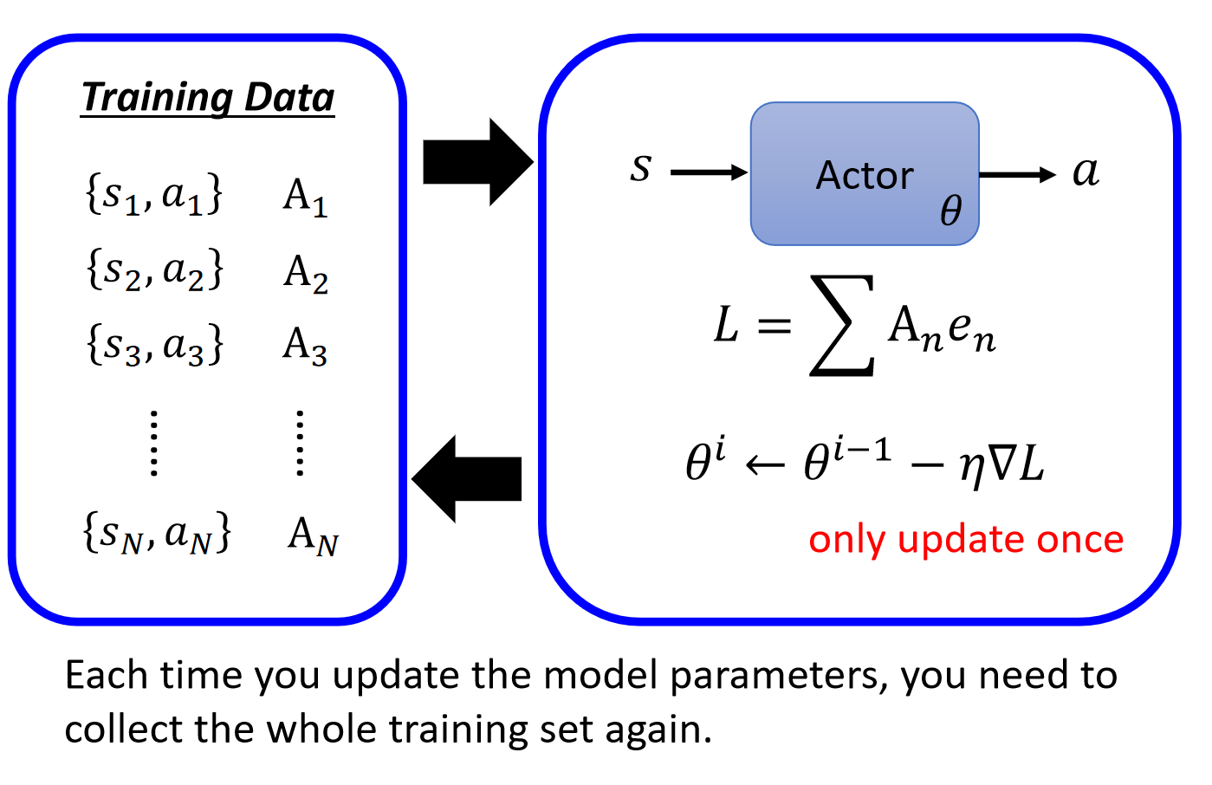
Holicy Gradient

Slide 29
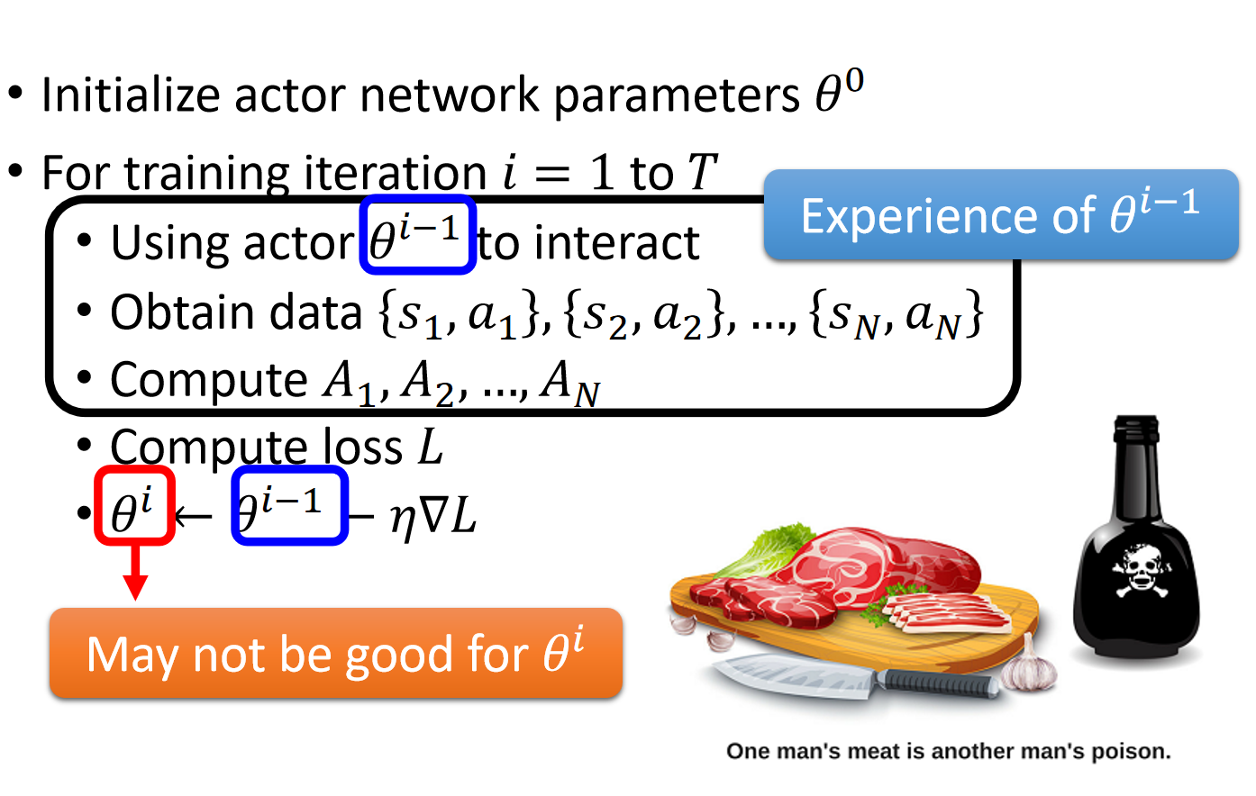
Holicy Gradient
Notes:
同一个action由不同的actor做出得到的效果是不同的，所以不能用$θ^{i−1}得到的$结果来评价$θ^{i}$。所以收集数据的actor与被评价的actor最好是同一个。由于每次行动结束都要重新收集数据，下一页给的是on-policy与off-policy

Slide 30
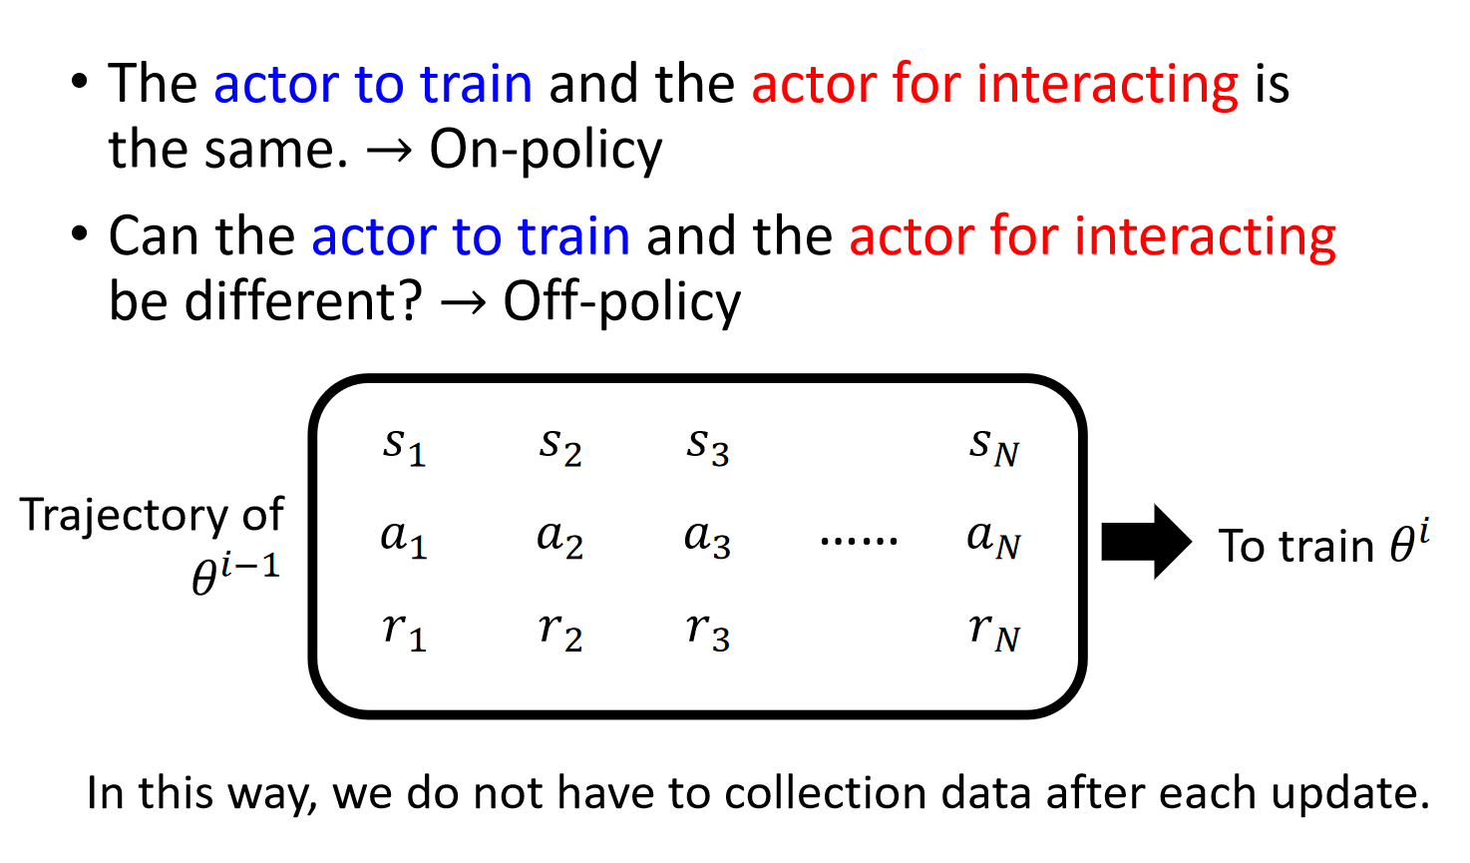
On-policy v.s. Off-policy

Slide 31
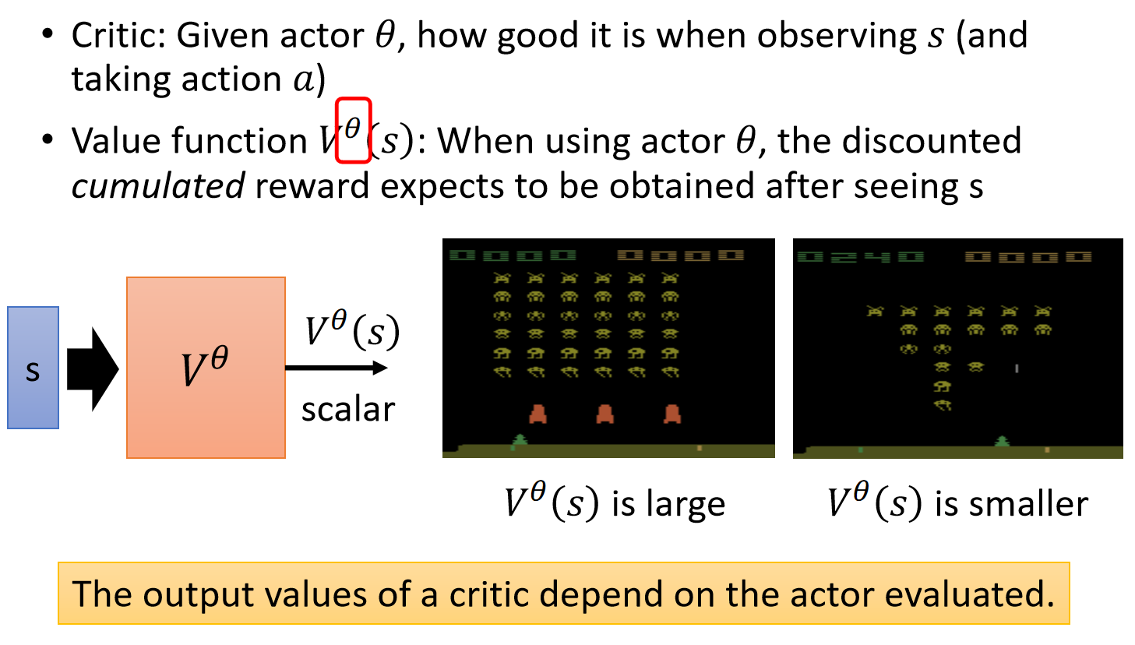
Actor-Critic

Slide 32
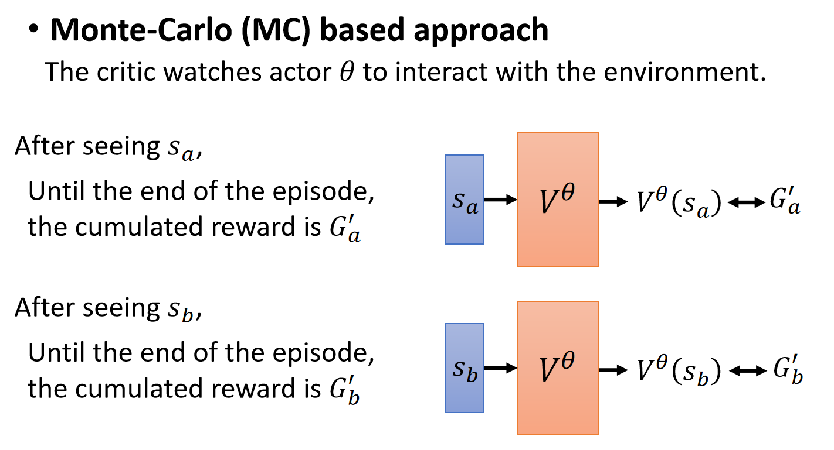
Actor-Critic

Slide 33
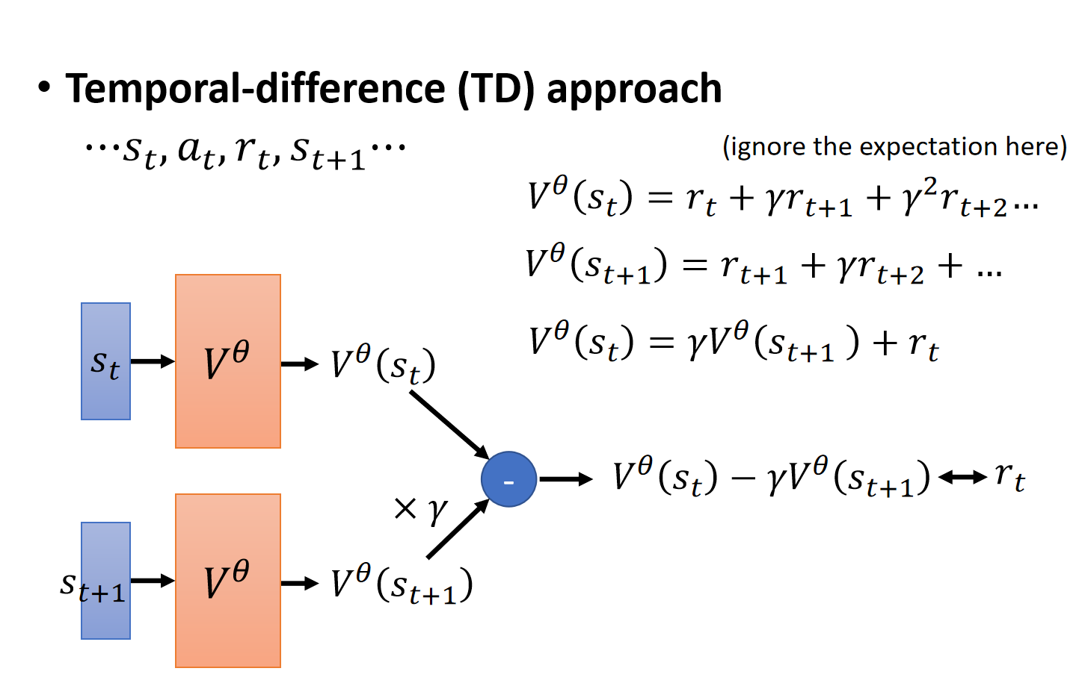
Actor-Critic

Slide 34
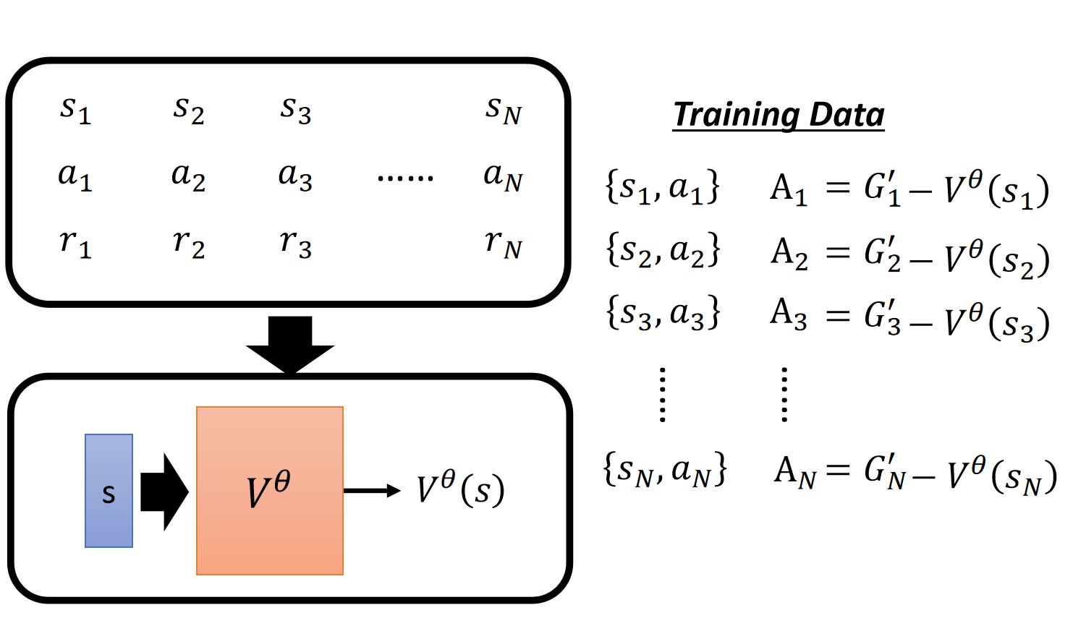
Actor-Critic
Notes:
$$A_{t}>0$$
$a_{t}$ is better than average.

Slide 35
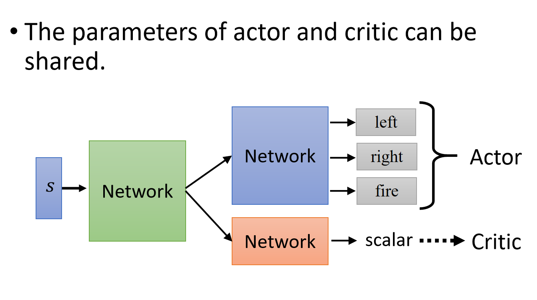
Actor-Critic

Slide 36
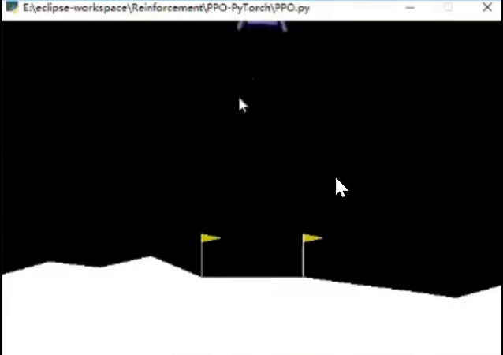
Example
Notes:
一个简单例子，飞机正常着陆时reward为正，此视频为训练过程，下一页为训练结果

Slide 37
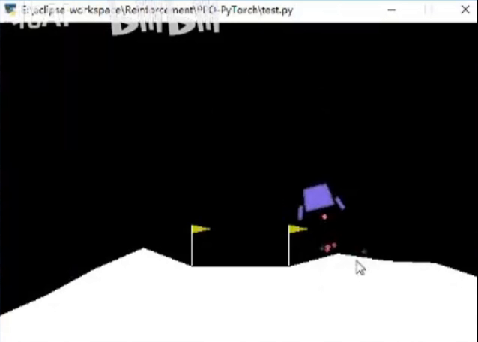
Example
Notes:
这个为训练结束时的样子

Slide 38
06
Practical Implementation and Case Studies

Slide 39
Setting Up a Reinforcement Learning Environment
01
02
03
Environment Design
Simulation vs. Real-World Environments
Tools and Frameworks
Designing a reinforcement learning environment involves defining the states, actions, rewards, and transition dynamics. The environment should be designed to reflect the real-world problem and provide meaningful feedback to the agent. It is important to consider the complexity and scalability of the environment.
Reinforcement learning can be implemented in both simulation and real-world environments. Simulation environments allow for faster and safer training, but they may not capture all the complexities of the real world. Real-world environments provide more realistic data but can be more challenging and time-consuming to work with.
There are several tools and frameworks available for implementing reinforcement learning, such as OpenAI Gym, which provides a wide range of environments and interfaces for developing and testing reinforcement learning algorithms. Other tools include TensorFlow and PyTorch, which offer powerful libraries for building and training neural networks.

Slide 40
Implementing Reinforcement Learning Algorithms
Coding a Basic RL Algorithm
Best Practices and Tips
Debugging and Tuning
Implementing a basic reinforcement learning algorithm involves writing code to define the agent's policy, value function, and update rules. This can be done using programming languages like Python and libraries such as NumPy and TensorFlow. The implementation should include functions for selecting actions, updating the value function, and evaluating the agent's performance.
Debugging and tuning are important steps in implementing reinforcement learning algorithms. Common issues include convergence problems, poor exploration, and incorrect reward functions. Tuning involves adjusting hyperparameters such as the learning rate, discount factor, and exploration rate to improve the agent's performance.
Some best practices for implementing reinforcement learning algorithms include using experience replay to break the correlation between samples, normalizing the input data to improve training stability, and visualizing the agent's performance to identify issues. It is also important to thoroughly test the algorithm in different scenarios to ensure robustness.

Slide 41
Case Studies and Real-World Applications
Autonomous Driving
Autonomous driving is a significant application of reinforcement learning. The agent learns to control the vehicle's movements based on sensor inputs and environmental conditions. Reinforcement learning algorithms are used to develop policies for tasks such as lane keeping, obstacle avoidance, and route planning. The goal is to achieve safe and efficient autonomous driving.
Robotics and Manipulation
Robotics and manipulation tasks involve teaching robots to perform complex actions such as grasping objects, assembling parts, and navigating through cluttered environments. Reinforcement learning is used to develop policies that enable robots to learn from trial and error and adapt to different situations. This has led to advancements in robotic control and automation.
Game Playing and Entertainment
Reinforcement learning has been successfully applied to game playing, where agents learn to play games such as chess, Go, and video games at a high level. This has led to the development of intelligent game-playing agents that can compete with and even surpass human players. Reinforcement learning is also used in the entertainment industry to create more engaging and interactive experiences.

Slide 42
07
Conclusion and Future Work

Slide 43
Summary of Reinforcement Learning
Key Concepts and Methods
Reinforcement learning is a powerful approach to machine learning that involves an agent learning to make decisions in an environment to maximize cumulative reward. Key concepts include the agent, environment, reward, value functions, and policies. Methods such as dynamic programming, Monte Carlo methods, temporal-difference learning, and deep reinforcement learning have been developed to solve reinforcement learning problems.
Applications and Impact
Reinforcement learning has a wide range of applications in various fields, including robotics, gaming, finance, healthcare, and entertainment. It has led to significant advancements in these areas and has the potential to transform many industries. The impact of reinforcement learning is expected to grow as the technology continues to develop and mature.

Slide 44
Future Directions and Research Opportunities
Advancing Algorithms and Techniques
Future research in reinforcement learning will focus on advancing algorithms and techniques to improve the efficiency, scalability, and robustness of reinforcement learning systems. This includes developing more efficient exploration strategies, improving sample complexity, and combining reinforcement learning with other AI techniques such as transfer learning and multi-agent systems.
Interdisciplinary Research and Collaboration
Addressing Safety and Ethics
Addressing safety and ethics is a critical area of future research in reinforcement learning. This involves developing methods to ensure that reinforcement learning systems are safe, reliable, and ethical in their deployment. It also includes studying the impact of reinforcement learning on society and developing guidelines and regulations to govern its use.
Reinforcement learning is an interdisciplinary field that intersects with various domains such as psychology, neuroscience, control theory, and computer science. Future research will involve more interdisciplinary collaboration to leverage insights from different fields and develop more comprehensive and effective reinforcement learning systems. This will lead to new applications and advancements in the field.

Slide 45


Final Thoughts
Importance of Reinforcement Learning
Reinforcement learning is an important area of research and development in artificial intelligence. It has the potential to revolutionize many industries and solve complex problems that require adaptive and intelligent decision-making. Understanding the principles and methods of reinforcement learning is essential for researchers, practitioners, and students in the field of AI.
Encouragement for Further Exploration
The field of reinforcement learning is constantly evolving, and there are many opportunities for further exploration and innovation. Researchers and practitioners are encouraged to delve deeper into the various methods and applications of reinforcement learning, experiment with different algorithms and techniques, and contribute to the advancement of this exciting field.

Slide 46
THANK YOU

